Slide 1
Network Slicing Use Cases
draft-qin-netslices-use-cases-00/01
Jun Qin, Kiran Makhijani, Jie Dong, Li Qiang, Shuping Peng
IETF98 Network Slicing Chicago 2017

Slide 2
Motivation
Recent discussion on netslices@ietf.org indicates that better understanding of use cases is needed
Although various 5G use cases has been widely discussed in NGMN, 3GPP etc. mobile community, it has not been discussed in IETF yet
This document tries to categorize 5G network slicing use cases and analyzed their requirements on the transport network
More contributions to use cases are welcome!

Slide 3
Taxonomy of Use Cases
Option-1: based on well-accepted 5G service types
  eMBB (enhanced Mobile Broadband)
  uRLLC (ultra-Reliable and Low Latency Communication)
  mMTC (massive Machine Type Communication)
Option-2: based on service modes
  Operator services
  Enterprise services
  OTT services
  Industrial Verticals
Option-3: based on service attributes
  Bandwidth, latency, jitter, reliability, security, etc.

Slide 4
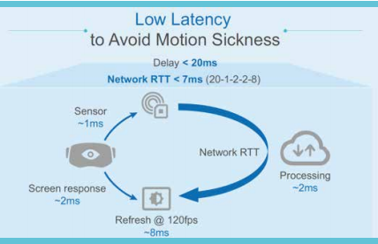
eMBB Type Use Case
Use Cases | Network KPIs
4K Video Streaming | 40Mbps
8K | 50 ~140Mbps
Mobile Video | Dynamic adaptive streaming 1) change in network conditions, 2) playback device
AR/VR | Bandwidth: up to 400Mbps, overall delay < 20 ms Network RTT < 7 ms
  Infrastructure for eMBB type slices
  Transport: High bandwidth/capacity transport
  Data/control: Customized protocols for video transmission
  Network Functions: Edge caches, encoders (for dynamic adaptive streaming)

Slide 5
eMBB Type Use Case
eMBB Network Assisted Video Service Assurance
Resource Schedulers
Network Monitoring
handheld
Cached Content
Encoders
PC
eMBB Data/Control Core protocol distribution
TV
eMBB Slice

Slide 6
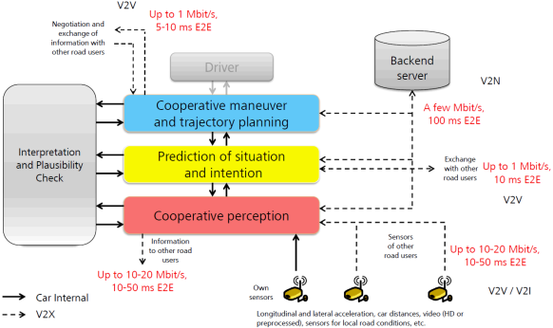
uRLLC Type Use Case
V2X special case:
More than one slice scenario
Different communication modes: V2V, V2I, V2P, V2N, etc.
Unique operation of their own network slices
Industrial Verticals
  Remote factory operation
  Vehicle-to-everything (V2X)
  Remote Surgery
V2X Use Cases | Network KPIs
Automated take over | latency: 10ms, reliability: 10⁻⁵
Cooperative Collision Avoidance | latency: 10-100ms, reliability:10⁻³-10⁻⁵
High Density Platooning | latency: 10ms, reliability: 10⁻⁵
See-Through | BW: 10Mbps, latency: 50ms
-- from 5GPPP

Slide 7
mMTC Type Use Case
  IoT flavors of use cases
  Smart Cities
  IoT devices exhibit different characteristics of delay sensitivity, traffic patterns, mobility modes.
  Access control and administration for cross city departments communication
  Remote Health monitoring
  Monitor physical conditions, accordingly and automatic take medical measures.
  Reliable and fast data exchange.
  Information privacy.

Slide 8
mMTC Type Use Case
Traffic department
Meteorology
& Climate dept
City planning & utilities
First Response
Access control and coordination
Information coordinators
Traffic Control App
Reporting App
Charging/Billing
Monitoring
Different app logic,
SLA and QoS
Traffic signals network
Smart meters
Emergency and surveillance camera
Weather sensors network
Different
- network access/data
protocols
mMTC Slice/Slices
Example: Smart cities interconnected infrastructure

Slide 9
Other Type Use Case
  Examples of existing services
  OTT Service models (e.g. content, voice, conferencing type services)
    Goal to simplify OTT infrastructures for
      New service verticals or evolution from existing to newer services
      OTT specific network function customization/Placement
      Better use of virtualization, Edge computing
  Perhaps add (as discussed on mailing list)
    vCPE Framework..
    Reliable VoIP services …

Slide 10
Requirements for Network Slicing
  Network operator view:
    A logical division into networks slices shall allow simpler orchestration, management and operation both for service operator and network operators
  Opportunities in industry verticals:
    With an independent control of portions of network resources, industry verticals can test and deploy services quicker.
  5G context:
    5G blurs the boundary between fixed and mobile networks. New network infrastructure needs.
  Transport context:
    The transport network should give a customized topology built for a different network slices, and provide the network resources and performance characteristics.

Slide 11
Discussion
  Please provide review and comments
  Collaborate designing use cases
  Next steps?

